Slide 1
Authentication as a Service
IdentityServer4

Slide 2
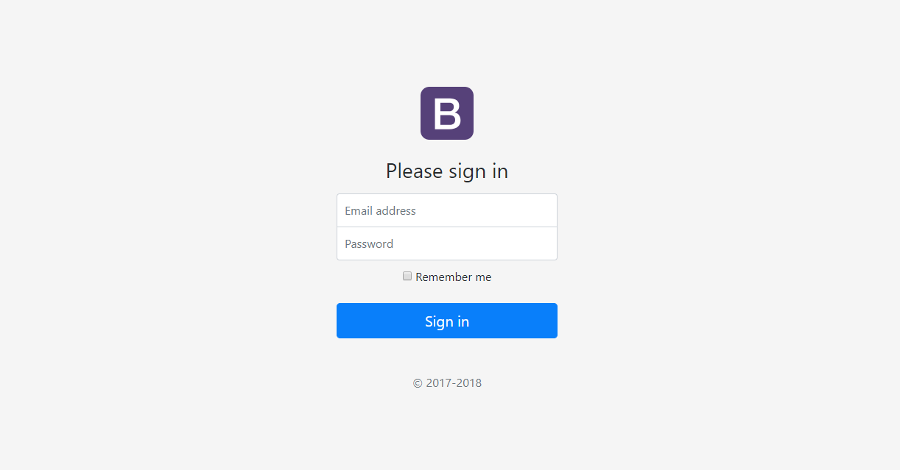
COMMON APPS

Slide 3
What is Authentication?
Identification
Authentication
Authorization

Slide 4
Authentication ways
HTTP Basic Authentication
HTTP Digest Authentication
Forms Authentication
Token Authentication
OAuth2 & Open ID Connect

Slide 5
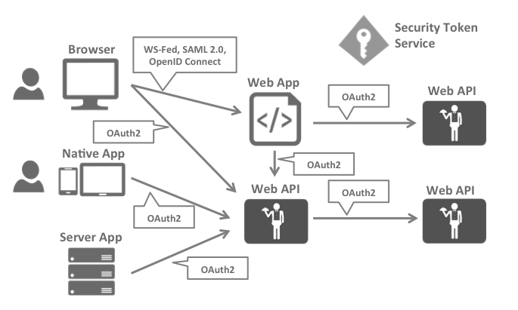
OAuth2 & Open ID Connect
OpenID Connect and OAuth 2.0 are very similar – in fact OpenID Connect is an extension on top of OAuth 2.0. The two fundamental security concerns, authentication and API access, are combined into a single protocol

Slide 6
Terminology
OpenID Connect Provider (OP)
Client
User
Scope
Identity scopes – openid, profile, email
Resource scopes – various API
Authentication/Token Request
Identity Token
Access Token
Refresh Token

Slide 7
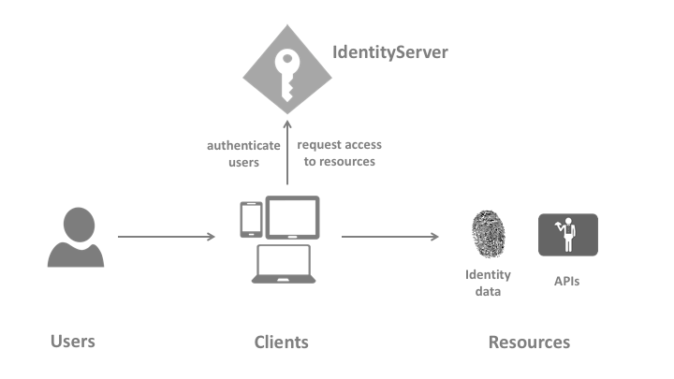
Authentication process
OpenID Connect and OAuth 2.0 are very similar – in fact OpenID Connect is an extension on top of OAuth 2.0. The two fundamental security concerns, authentication and API access, are combined into a single protocol

Slide 8
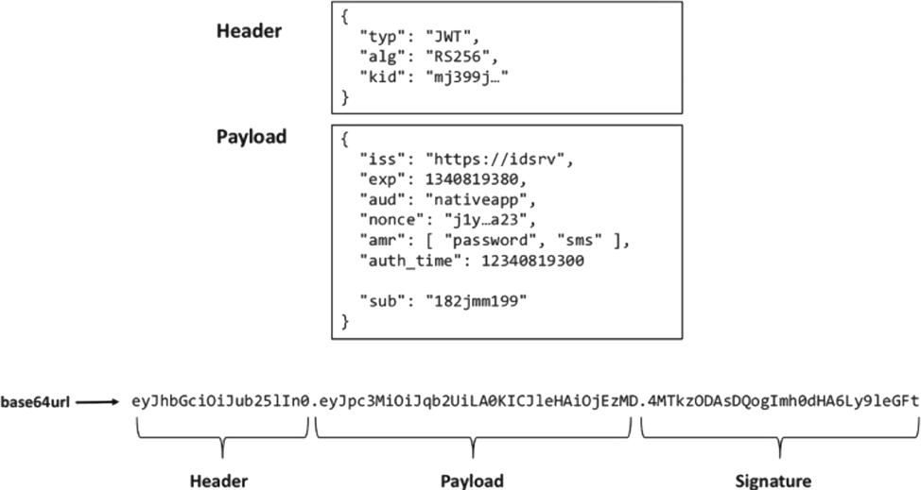
Token
JSON Web Tokens are an open, industry standard RFC 7519 method for representing claims securely between two parties. https://jwt.io/

Slide 9
Demo

Slide 10
Links
http://identityserver.io/
https://identityserver4.readthedocs.io/en/release/index.html
https://github.com/IdentityServer
https://github.com/brockallen
https://github.com/leastprivilege
https://github.com/scottbrady91
https://brockallen.com/
https://damienbod.com/
https://www.identityserver.com/products/#AdminUI

